Slide 1
Introduction to Web Development
Web Design and Development
Pre-requisites:
Programming
Database

Slide 2
Course Contents/Outlines
Introduction to Web
Terminologies Used in this Domain
Hypertext Markup Language - HTML
Cascading Styling Sheet - CSS
Client-Side Scripting – JavaScript
Server-Side Scripting – PHP/Java/JavaScript/Python
Application Programming Interface
Full-Stack Applications

Slide 3
Introduction to Web & Its Terminologies
New Topic

Slide 4
What and why web?
A global system of interconnected documents and resources accessible via the internet, primarily using web browsers
Allows users to access, share, and navigate information through hyperlinked web pages
Used for information retrieval, communication, online transactions, and entertainment
Enables businesses and individuals to create and maintain websites for various purposes, including e-commerce, education, and social interaction

Slide 5
How does it work?
You have laptops, gadgets and computers
You decide to open a selling point in real world
You will have to rent a space to house it
Website is the same but you rent a space digitally (server)
In foreign, you need to give rent and a registration fee to register your shop’s name
Similar on the internet, space is what we refer to as ‘hosting’
Registration name is what we refer to as ‘domain name’

Slide 6
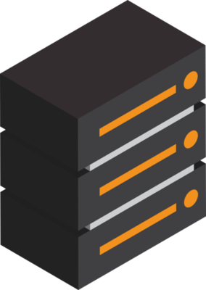
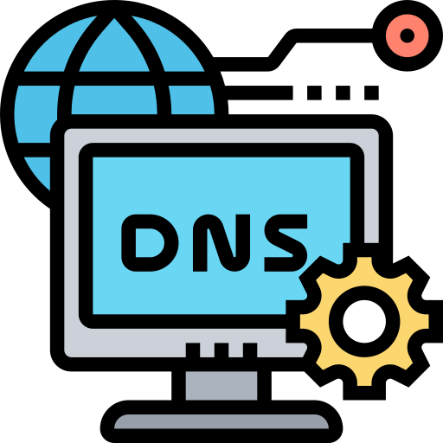
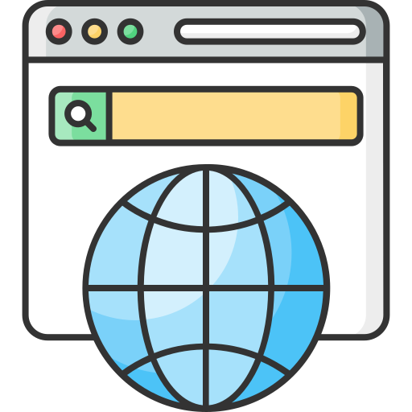

How does it work?
Server
(Sells/Operate Digital Space)
Domain Name System
(Dictionary for Domains and IP Addresses)
Web Browser
(Rendering Tool)
World Wide Web
(The Internet)
Has its own unique IP address
192.168.1.1
Any device on the internet can connect to this server using its IP
We can't remember the IP addresses, so we give them names
Which is what we know as ‘web-address’ or ‘domain name’
We type www.google.com in our browser
The browser sends this URL to DNS
DNS searches the IP against this URL
DNS sends the IP found, back to browser
Browser use the IP to send ‘request’ to the original Google Server
Google server gets the ‘request’ and sends back ‘HTML’, ‘CSS’ and ‘JavaScript’ code to the browser
The browser renders the files
Browsers take URLs or Domains
Can request data from DNS or Servers
Renders the code/files received from the DNS or Servers
A digitally interconnected network of all devices, web-browsers, websites, servers, etc.

Slide 7

How does it work?
Server
DNS
(HTTP: [GET, POST])
request
domain name
response
(HTML, CSS, JavaScript)
IP address
Browser

Slide 8
Client vs Server
Client is someone who sends a ‘request’
Server is someone who gets the request and send back ‘response’
Server meaning serving or someone providing service
Server
Client
sends
‘request’
‘response’
sends

Slide 9
Front-End vs Back-End vs Full-Stack
Front-End Development
User interface and design
HTML, CSS and JavaScript
Building and styling the website
Back-End Development
Server-side logic
Database management
Full Stack
Both Front-End and Back-End
Complete web application from start to end

Slide 10
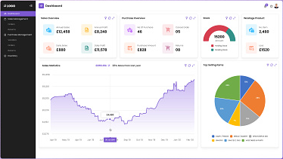
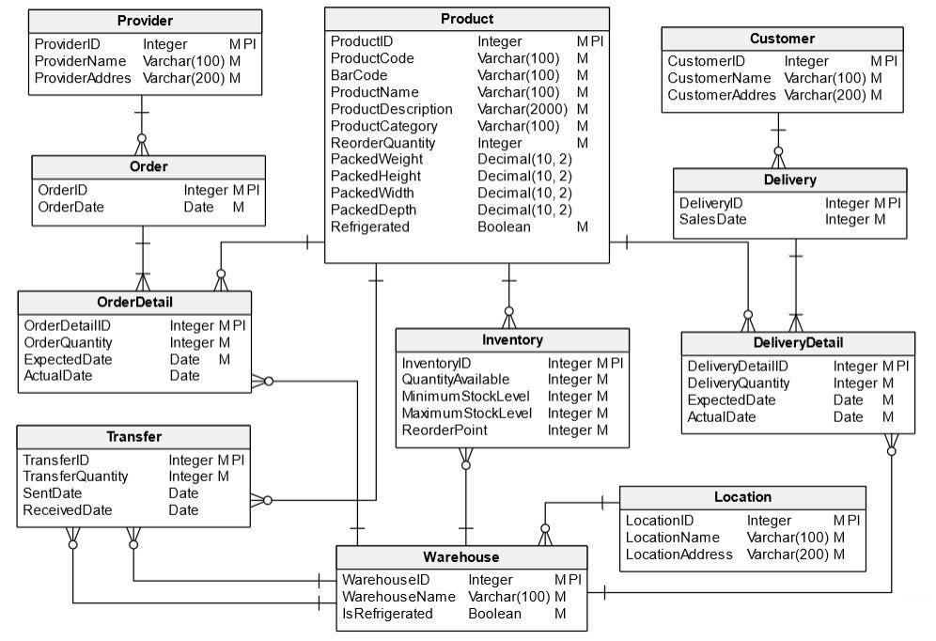
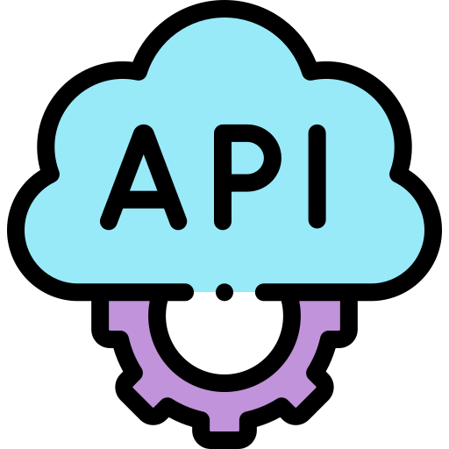
Front-End vs Back-End vs Full-Stack
Application
Programming
Interface
Front-End Development
Back-End Development

Slide 11
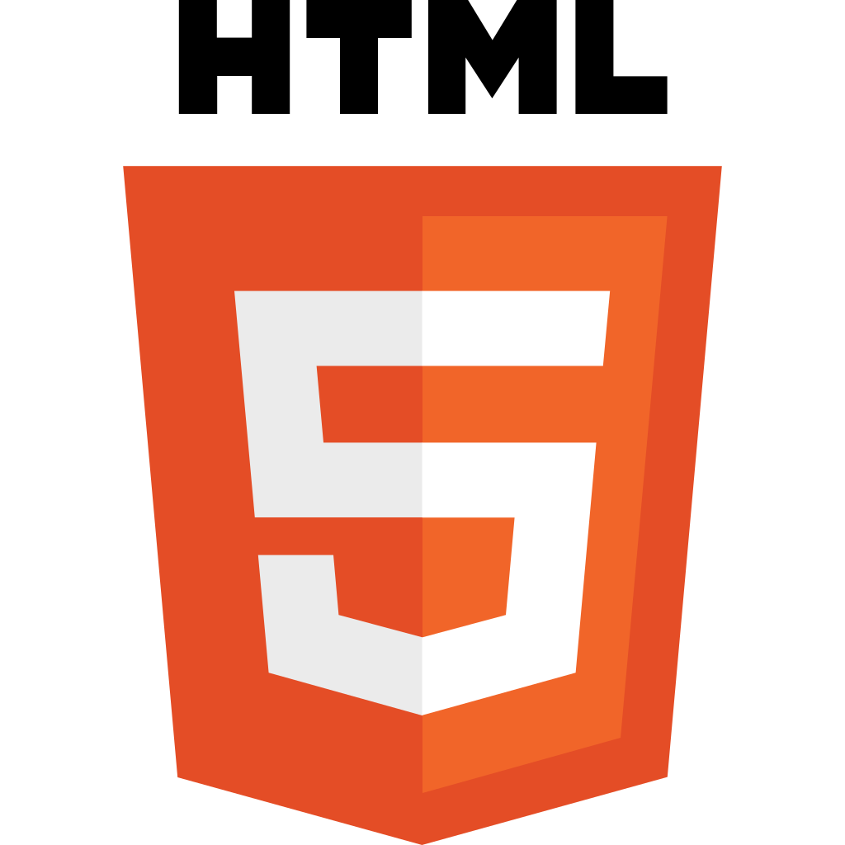













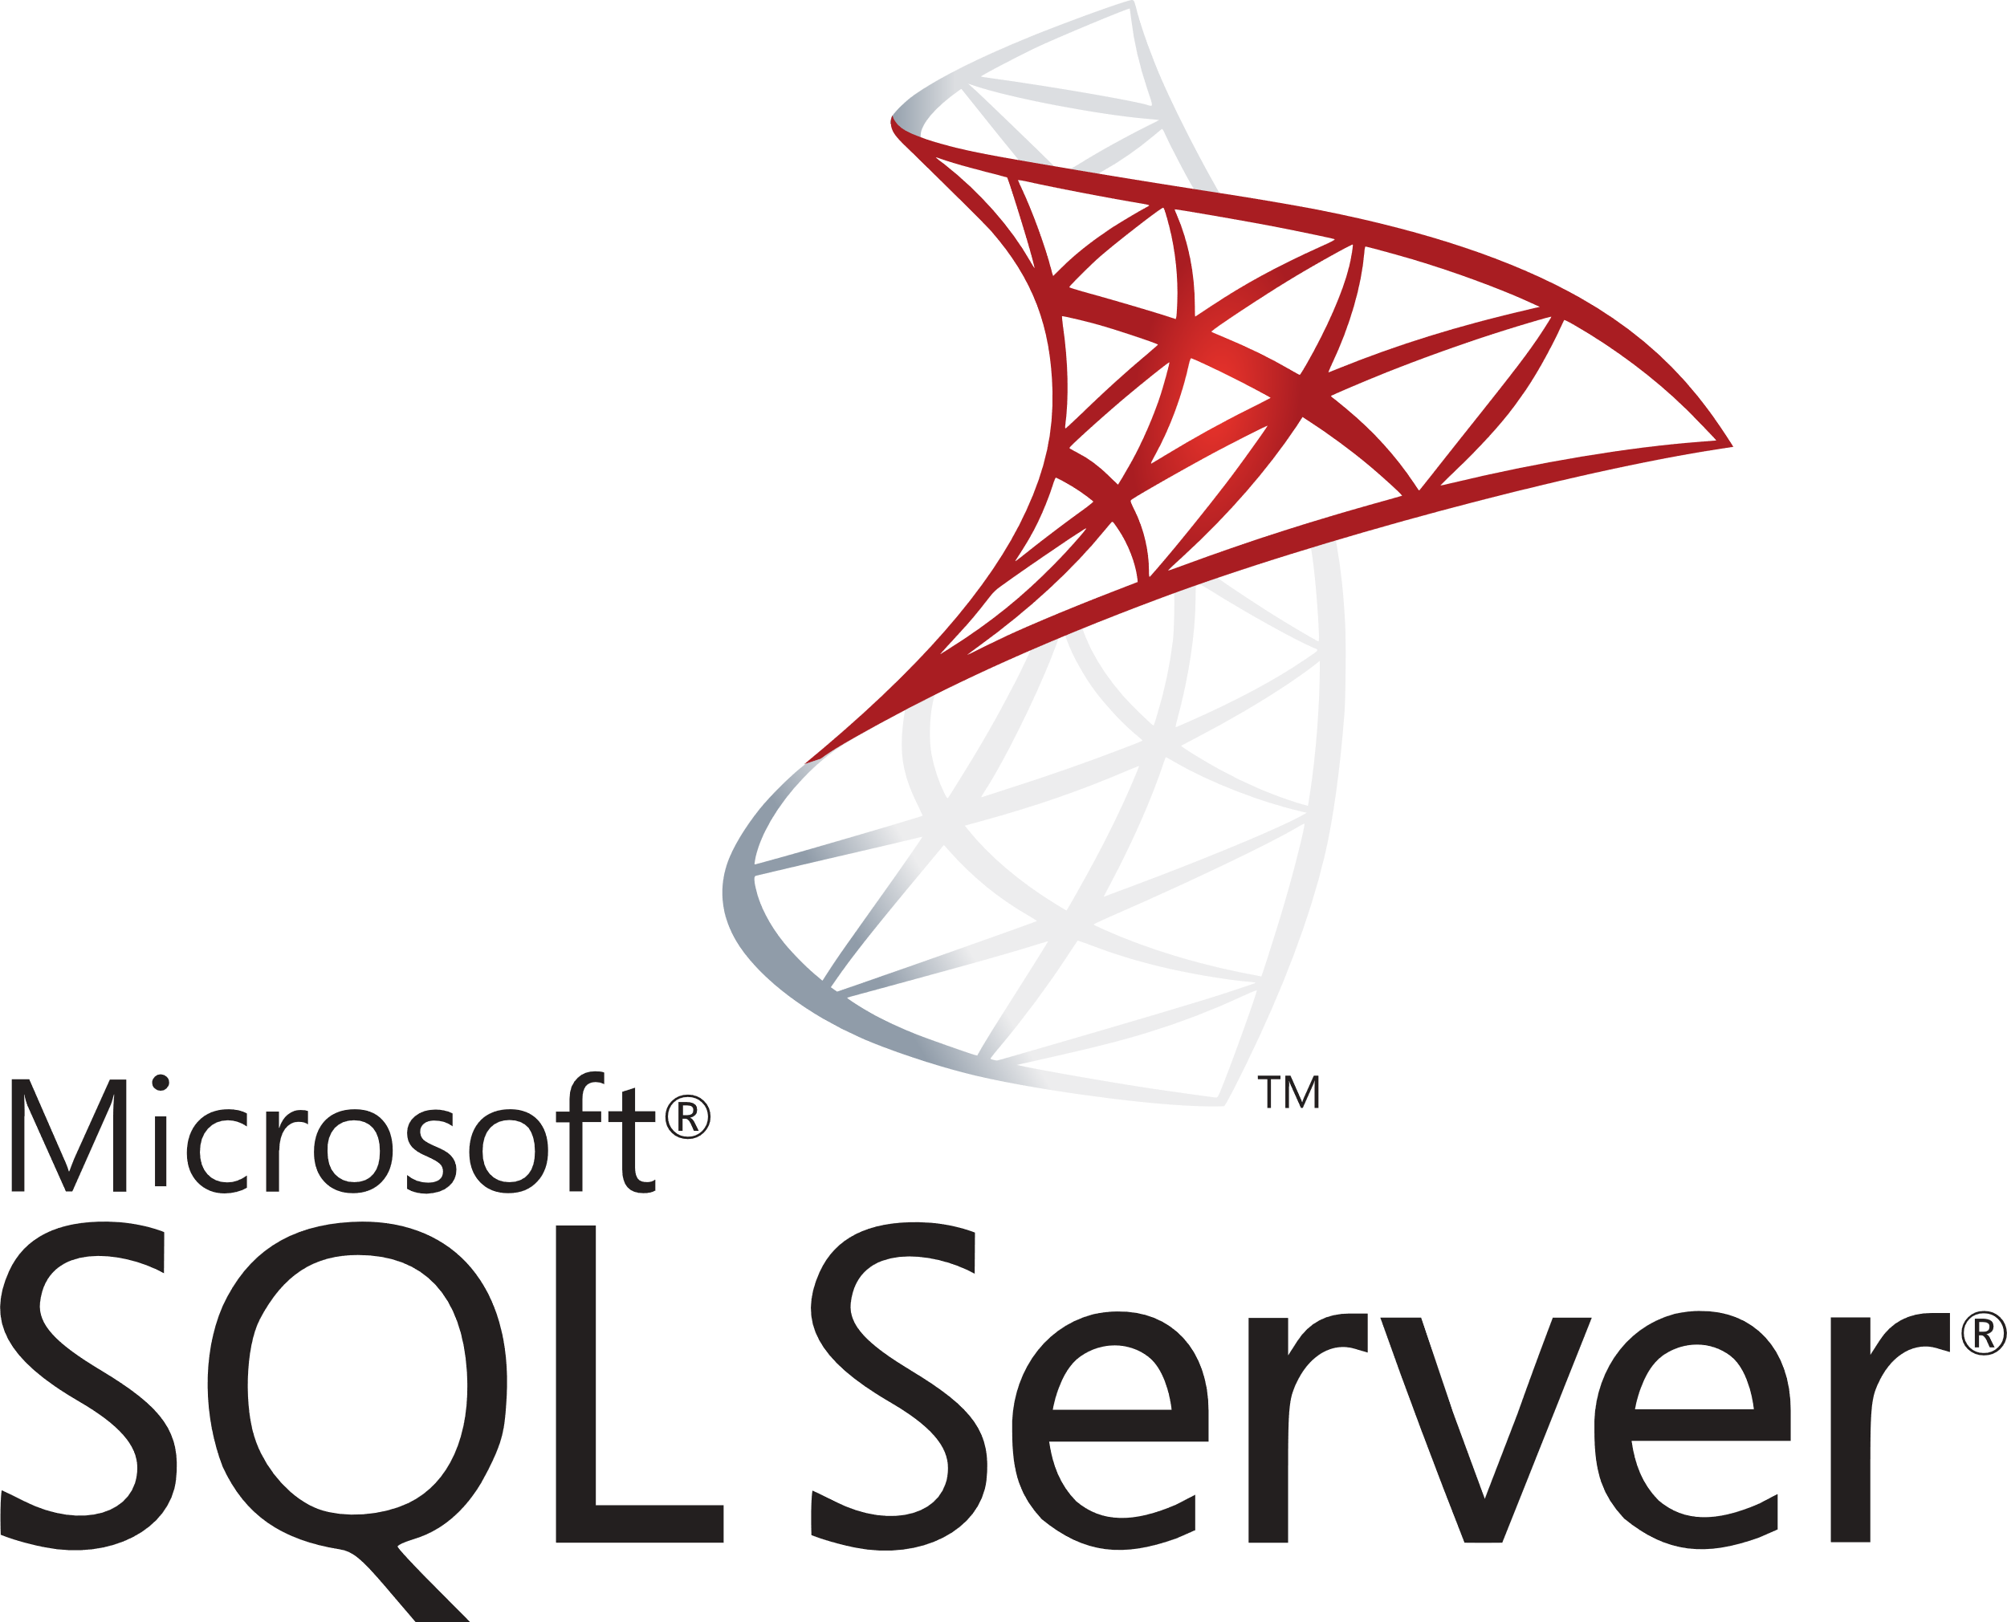





Front-End vs Back-End vs Full-Stack
Front-End Development
Application Programming Interface
Back-End Development

Slide 12
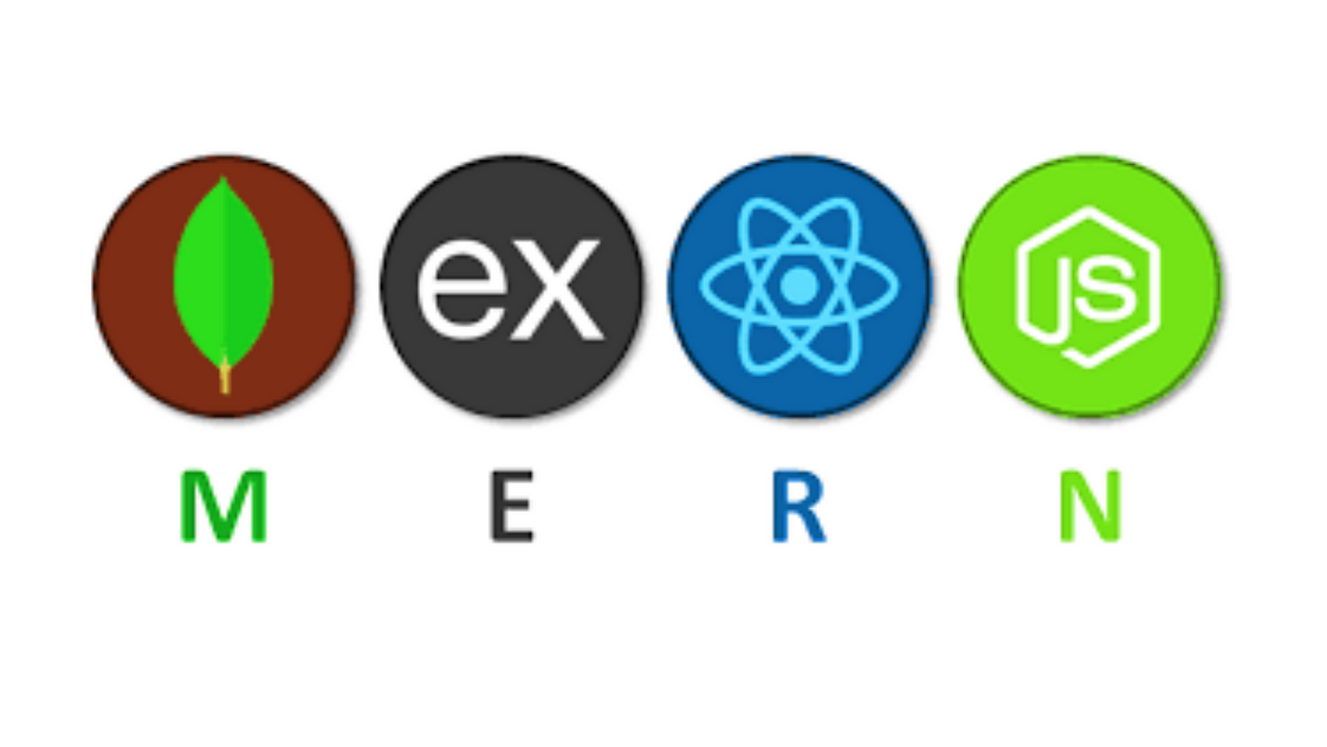

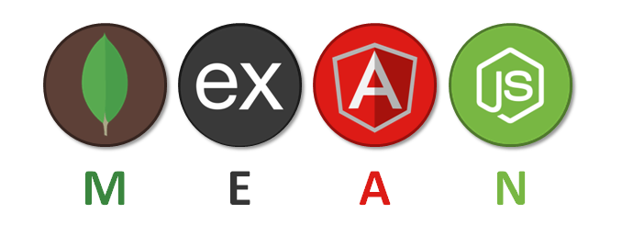
Full Stack – Two Famous Choices
1. MERN Stack
2. MEAN Stack

Slide 13
Main Tools Used to Develop a Website
There are three main tools commonly used,
HyperText Markup Language (HTML)
Building block – structure and layout
Cascading Styling Sheet (CSS)
Appearance – color, arrangement, responsiveness
JavaScript (JS)
Behavior – functionality, interaction, dynamics

Slide 14
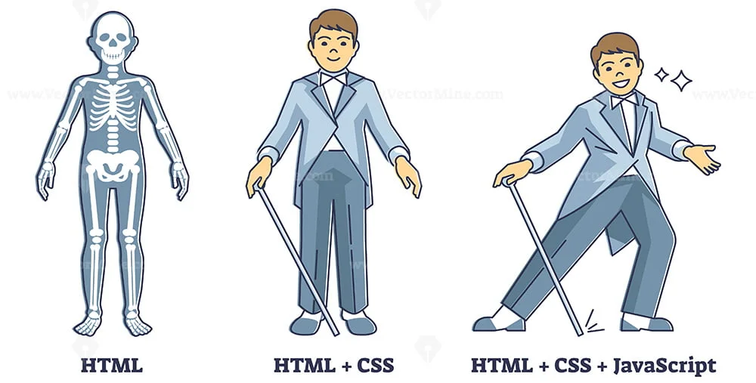
Main Tools Used to Develop a Website

